Slide 1


P2N STEM: Teaching science, technology, engineering, and math with a focus on Python,
microphone, and robotics.
This July, we're hosting a STEM workshop on July 11, 18, & 25, 9:30 AM - 3:00 PM. We'll explore robotics with Python and create impressive LED displays! We focus on equity, innovation, and sustainability in STEM education.
Notes:
1

Slide 2
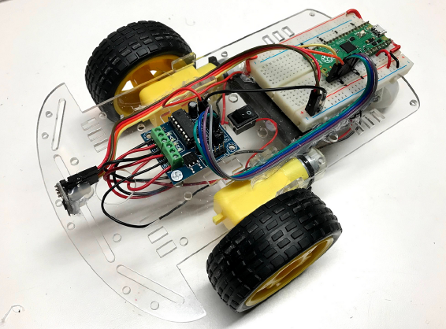
Build Your Own STEM Robot!
Robot Kit Components
Dive into robotics with these parts! Smart Car Chassis ($4) for movement. Raspberry Pi Pico ($4) for the brain. Breadboard ($2) for easy wiring. Distance Sensor ($4) to detect objects. Motor Driver ($2) to control motors and OLED Displays ($18).
Total Cost Per Student
All these cool parts cost only $23 Per Student! Build your robot and learn about STEM.
Notes:
2

Slide 3
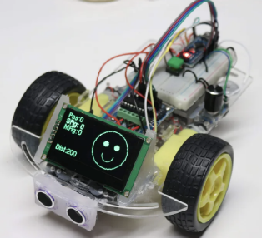
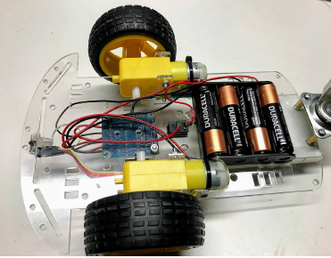
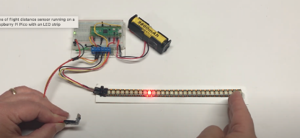
Building a Low-Cost Raspberry Pi Robot
Key Components
Construction
Programming
VL53L0X time-of-flight sensor
Mount the Raspberry Pi Pico on a breadboard attached to the chassis. Use power connections, PWM signals, and I2C connectors for sensor data.
Program the Raspberry Pi Pico fully in Python. Students can use web-based tools like trinket.io.
Raspberry Pi Pico W
L293D motor controller
128x64 OLED display
The L293D motor driver board regulates voltage, powering the Pico. Power the robot with 4 AA batteries for a 6V DC source.
while True:
dist = read_sensor()
if dist < TURN_THRESHOLD:
print('object detected')
reverse()
sleep(BACKUP_TIME)
turn_right()
sleep(TURN_TIME)
else:
forward()
These components provide centimeter-accurate readings, wireless microcontroller capabilities, motor control, and display functionality.

Slide 4
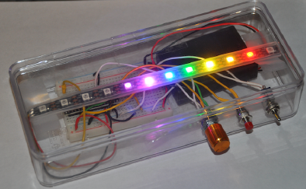
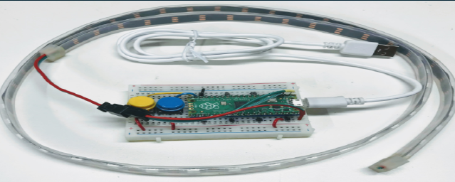
Build a Moving Rainbow STEM Kit
Learn computer science basics with a fun, hands-on project! These kits use low-cost parts. Each kit will help you build your own moving rainbow. Take it home and show your friends! Here is a list of Parts:
Total Cost Per Student
Raspberry Pi Pico ($4)
All these cool parts cost only $18 Per Student! Build your robot and learn about STEM.
10-element LED strip ($4.70)
Mini breadboard ($2)
Battery holder ($0.70)
Polystyrene Box ($2.50)
Microcontroller Wire $6.00
On-off switch ($1.00)

Slide 5
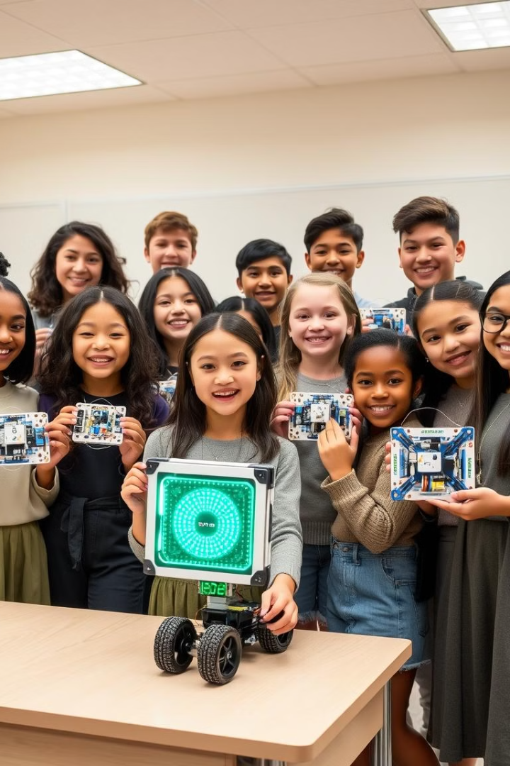
Affordable STEM for Everyone
Our goal at P2N is to provide affordable STEM education for all. We focus on diversity and inclusion, targeting underprivileged youth. Join us in teaching robotics, sustainability, and AI! Let's inspire the next generation of innovators.
Notes:
5

